Slide 1
Is Video Game Emulation the Same as Piracy?
By: Colin quinn

Slide 2
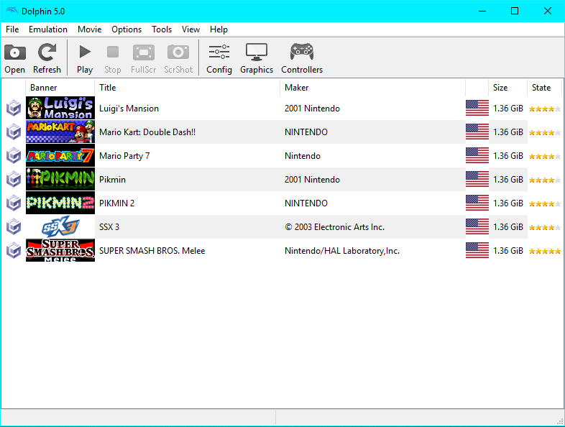

What is Emulation?
2 Main Parts:
The emulator
A ROM and ISO, or disk image

Slide 3
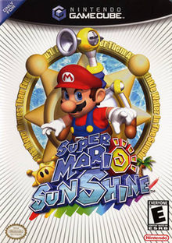
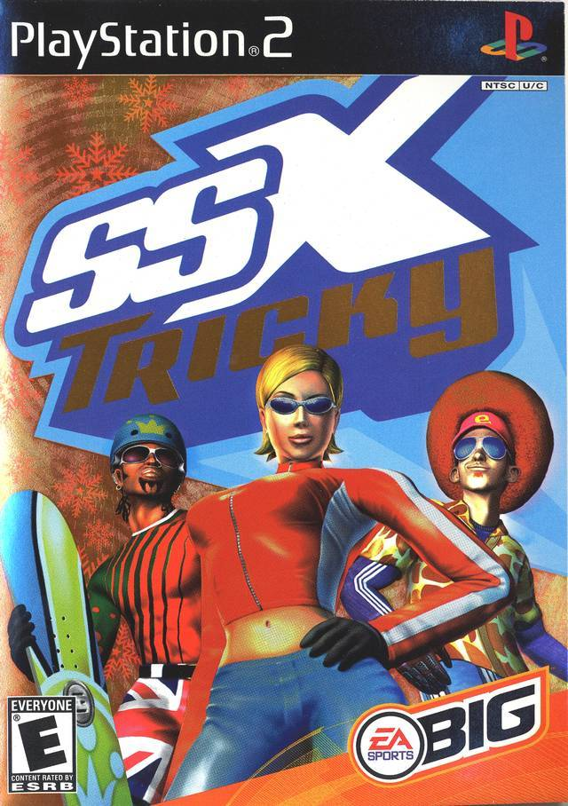
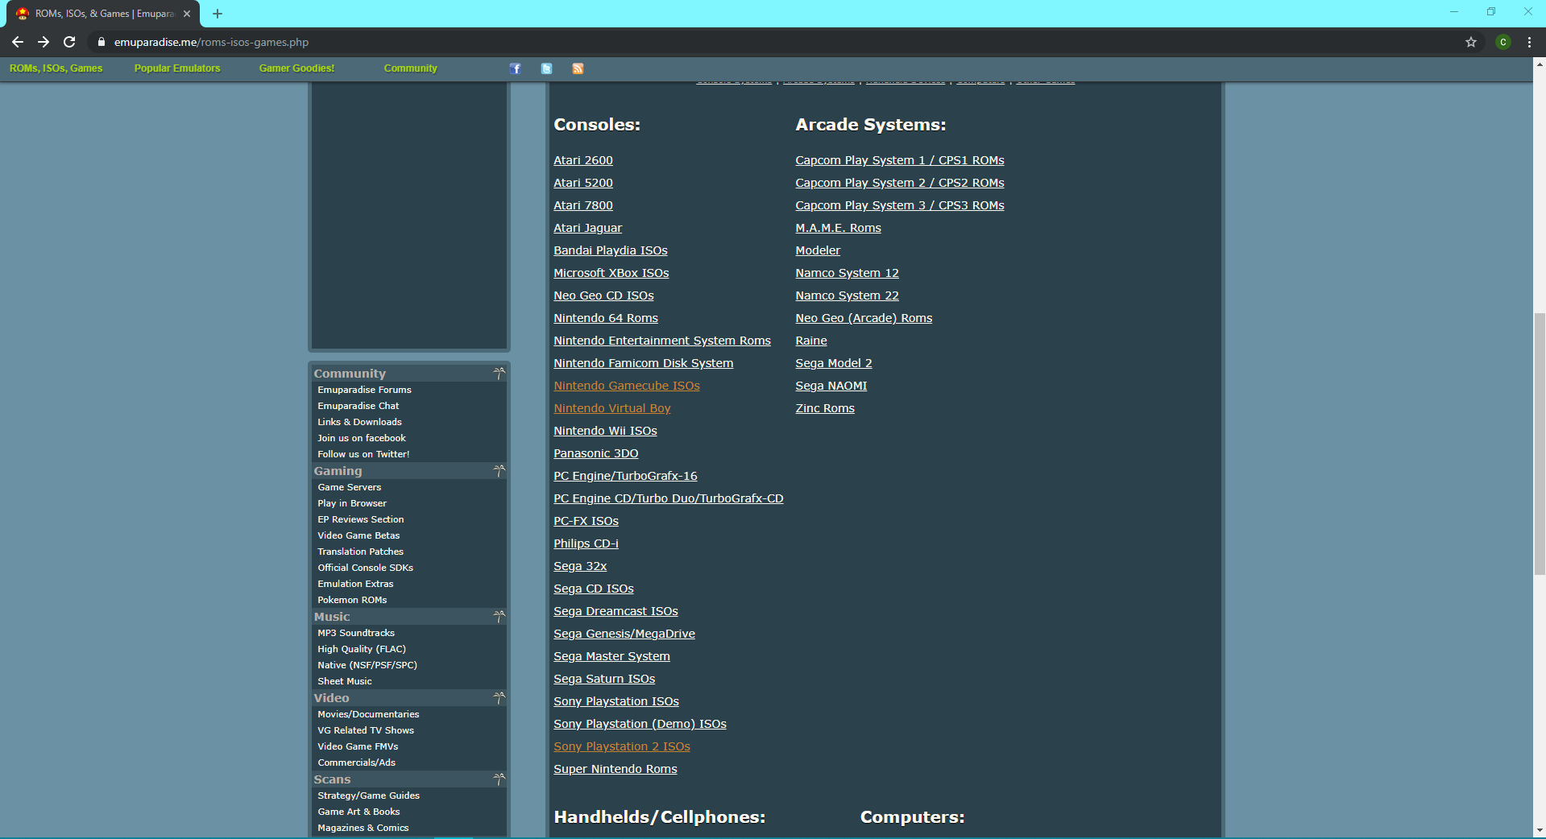
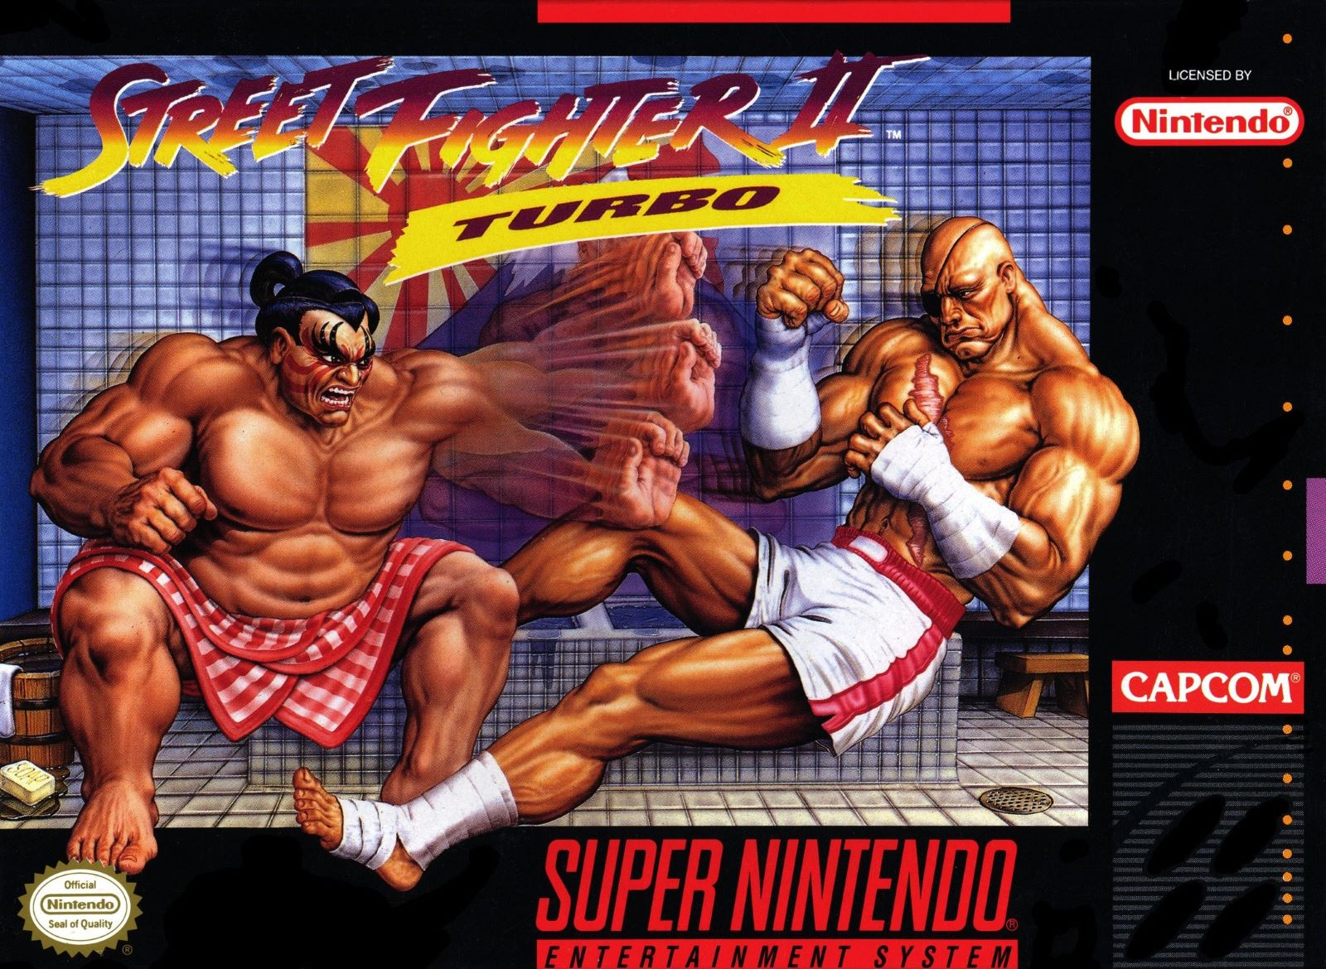
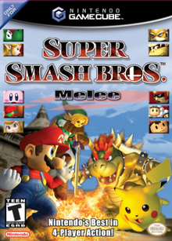
Emulation: The Good
Allows younger generation to experience the history of games
Nostalgia for those who grew up playing these games
Emulation allows for digital archives of classic video games
MasJ, creator of EmuParadise.com: “We run EmuParadise for the love of retro games and for you to be able to revisit those good times.”

Slide 4

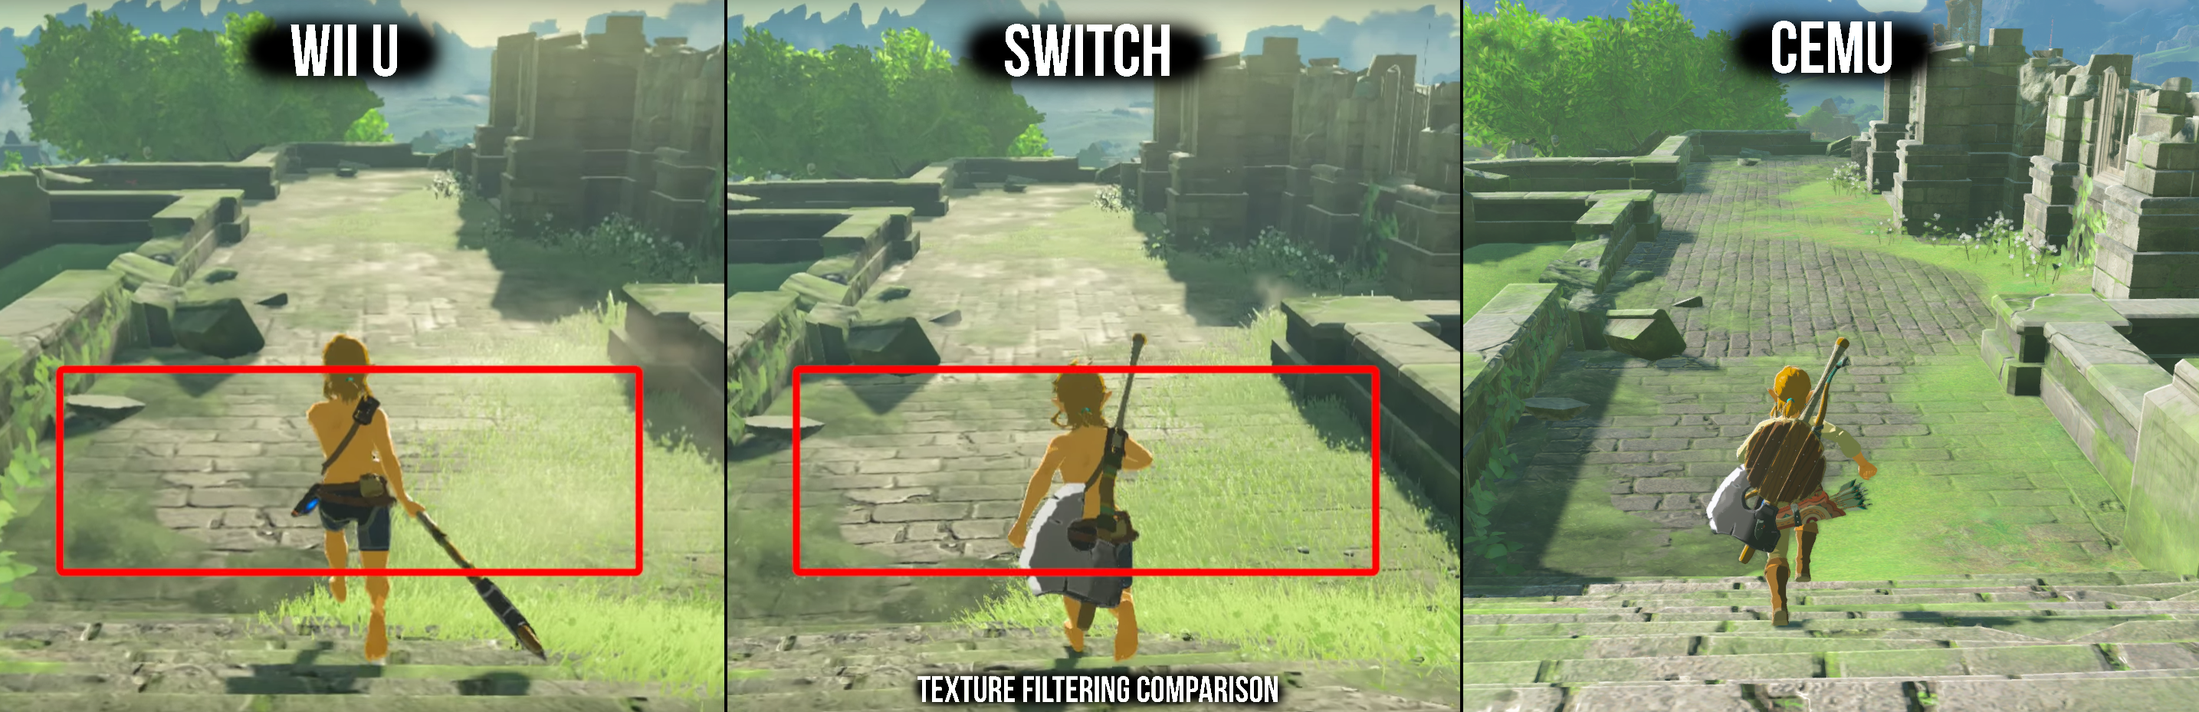
Emulation: The Bad
Distributing ROMs is technically piracy
Revenue loss for the game developers
Emulators for current generation consoles such as Cemu

Slide 5

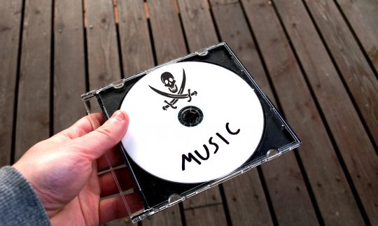
Similar Situations
The Film Industry
“The List of Lost Films” contains titles from 1890’s to 1970’s
Estimated to have lost 75% of all silent films
The Music Industry
LimeWire enabled free access to music (like EmuParadise)
Direct impact on revenue causing strict enforcement

Slide 6

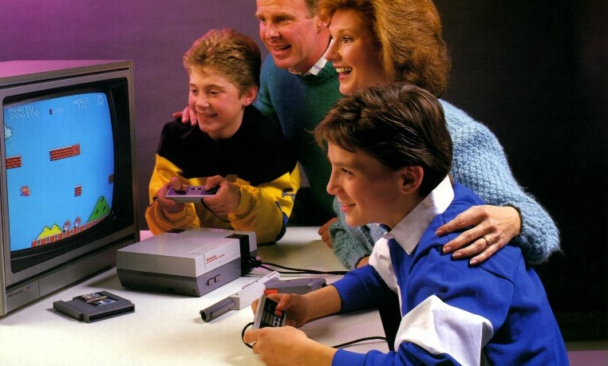
Who is Involved in Emulation?
Game Development Companies
Responsible for providing a quality experience
Emulator Developers
Responsible for creating a way to play older generation games
Current and Future Consumers
Responsible for providing money in exchange for experiences

Slide 7
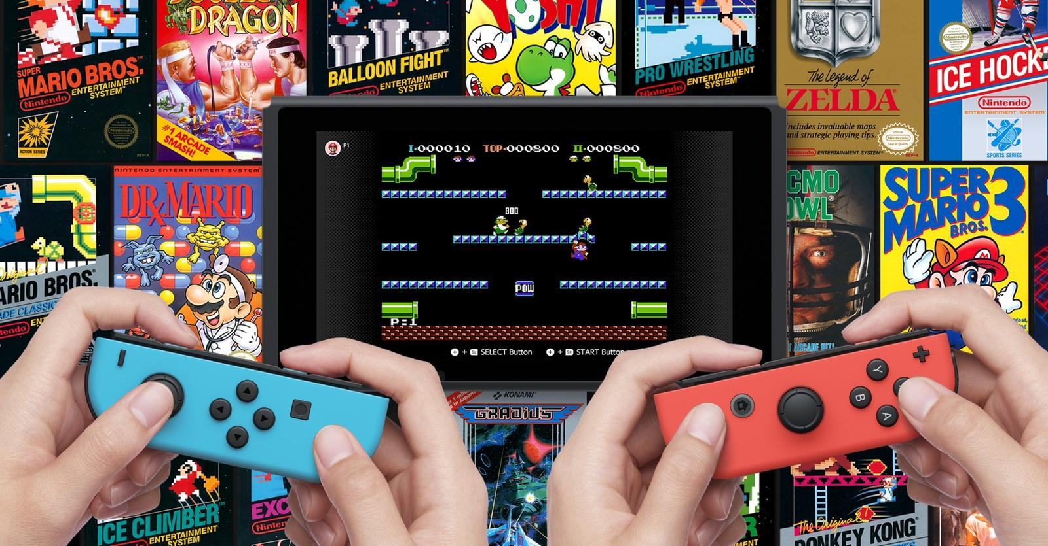
What Alternatives Are There?
Agreement between game and emulator developers to both provide a high-quality experience
Emulators are typically funded through donations
Game developers shut down distribution of ROMs
Archiving games becomes dangerous
Only publishing companies have access to the IP
Game developers “remaster” all games for re-release
Can resell old products
Release the IP after a certain time frame (Ex: 15 years)
People are free to play older generation games
Game developers do not lose any revenue from new titles

Slide 8

Finding a Middle Ground
Most of the emulation community just wants access to an archive of older generation games
Game developers do not want to lose out on possible income
In both best interests, there are two options
Emulator and game developers agree to work together and sell the product
Release the IP after a predetermined amount of time

Slide 9
Analysis of Options: Developers Work Together and Sell the Product
Utilitarianist Approach:
Maintains classic game archives
Creates company revenue
Deontologist Approach:
Allows community to keep access to classic games and support developers
Game developers can provide a good user experience

Slide 10
Analysis of Options: Release IP after 15 Years
Utilitarianist Approach:
Games become free to play for anyone that is interested in them
Supply as many people as possible with an enjoyable experience
Deontological Approach:
Not responsible for funding old games that are no longer purchasable
The IP has sold essentially all that it will by the time it should be opened

Slide 11
Conclusion:
Using Utilitarian Ethics:
The entire community gaining access to these games for free achieves maximum happiness produced
Using Deontological Ethics:
Developers working together provides the overall maximum happiness, even if it might come with a slight price tag
Do you use emulators? What are your thoughts on them?

